Slide 1
DSCI-6004-01 NATURAL LANGUAGE PROCESSING GENERATING A CAPTION FROM AN IMAGE
Team 14:
Basani Sneha Latha Reddy
Gnaneswari Vaddepalli
Teja Reddy Soma
Guided By : Khaled Sayed, Assistant Professor

Slide 2
INTRODUCTION AND OBJECTIVES
INTRODUCTION:
Image captioning is a task in Natural Language Processing (NLP) and Computer Vision that involves generating a descriptive textual caption for an image. It combines techniques from image processing to understand the visual content and NLP to create coherent and meaningful text.
WHAT IS IMAGE CAPTIONING?
Image captioning refers to the task of generating a textual description for an image. This combines elements of computer vision and natural language processing (NLP). The aim is for a model to generate contextually relevant captions that describe the content of an image in human-like language. It involves understanding the image content, detecting key objects, and then generating grammatically correct and contextually appropriate sentences that convey the key details.
OBJECTIVES:
To, contextually relevant captions for images.
To implement a visual attention mechanism that helps focus on specific image regions during caption generation.
To evaluate the model on a publicly available dataset (Flickr8k) and benchmark its performance.
To create a user-friendly interface for real-time caption generation from uploaded images.

Slide 3
APPLICATIONS:
Social media: Generating captions for images uploaded to social media platforms
E-commerce and Retail: Describing product images with captions for better search engine optimization and enhanced customer experience.
Autonomous Vehicles: Describing surroundings and identifying objects in real-time to aid decision-making in navigation systems.
Medical Imaging: Assisting doctors by automatically describing medical images, such as X-rays, MRIs, or CT scans.
Real-Time Translation Systems: Captioning images with translations in different languages for cross-cultural communication.

Slide 4
CHALLENGES AND RELEVANCE
CHALLENGES:
Contextual Understanding: Traditional models often fail to generate captions that capture the context or fine-grained details of an image.
Generalization: Many models struggle to perform well on unseen datasets or real-world scenarios due to overfitting or bias in training data.
Computational Complexity: Attention mechanisms, though effective, are computationally expensive, making them difficult to scale.
Data and Labeling Limitations: High-quality image-caption datasets are labor-intensive to curate, and biases in data can lead to poor model generalization.
Handling Ambiguity: Images with multiple objects or actions can result in ambiguous captions, requiring advanced reasoning capabilities from the model.

Slide 5
RELEVANCE:
Real-World Applications: Image captioning is essential for making visual data accessible and useful in various domains, including healthcare, robotics, and digital content management.
Advancements in AI: With the rise of deep learning and attention mechanisms, image captioning has seen significant improvements, offering potential for smarter systems that mimic human understanding.
Enabling Multimodal AI: Image captioning facilitates the integration of visual and textual data, moving AI closer to understanding and interacting with the world as humans do.
Automation and Efficiency: In industries like e-commerce or social media, automated image captioning improves efficiency, allowing for rapid content categorization and interaction.

Slide 6
METHODOLOGY
WORKFLOW:
Data Collection → Preprocessing → Feature Extraction → Model Training → Evaluation.
Data Collection:
We used the Flickr8k dataset, which contains 8,000 images, each with five human-generated captions.
Preprocessing:
Image Preprocessing: All images were resized to 224x224 pixels, normalized using ImageNet statistics, and converted into tensors for use in the model.
Text Preprocessing: Tokenization, vocabulary construction (with frequency thresholds), and encoding of captions into sequences were performed. Special tokens were introduced for unknown words.

Slide 7
Feature Extraction:
A ResNet50 model was used as a feature extractor for the images. The ResNet50 model helps capture high-level features and reduces dimensionality of the input image.
Model Training:
We used an LSTM-based decoder, combined with a visual attention mechanism, to generate captions. The attention module allows the model to focus on different parts of the image when generating each word of the caption.
Evaluation:
Performance was evaluated using standard metrics such as loss, accuracy, and F1 score. Additionally, a qualitative analysis was performed, including visualizing attention heatmaps to better understand which regions of the image were being attended to during caption generation.

Slide 8
MODELS AND TECHNIQUES
ENCODER-DECODER ARCHITECTURE:
Encoder (CNN): ResNet50 is used to extract image features, providing a compact representation of the visual content.
Decoder (RNN): LSTM networks are used to generate text, where the hidden state updates at each time step, based on the image features and the previously generated word.
ATTENTION MECHANISM:
The visual attention mechanism allows the model to dynamically focus on specific regions of the image as it generates each word. This improves the relevance and accuracy of the generated captions by focusing on salient image parts.
INTERACTIVE INTERFACE (Streamlit):
A Streamlit-based web interface was developed to allow users to upload images and get real-time captions generated by the model.

Slide 9
RESULTS AND ANALYSIS
PERFORMANCE:
The model showed significant improvements in generating contextually relevant captions, especially for complex or detailed images.
The F1 Score improved from 0.59 to 0.82 during training, indicating better balance between precision and recall.
The accuracy increased from 0.63 to 0.83, suggesting that the model improved in generating relevant captions.
SUMMARY OF RESULTS:
Training Results: Loss reduced from 3.64 to 1.14, showcasing the model's ability to learn better image-text relationships over time.
Validation Results: While the validation metrics were slightly lower than training, the model maintained a F1 Score of 0.66 and accuracy of 0.68, demonstrating robustness.

Slide 10
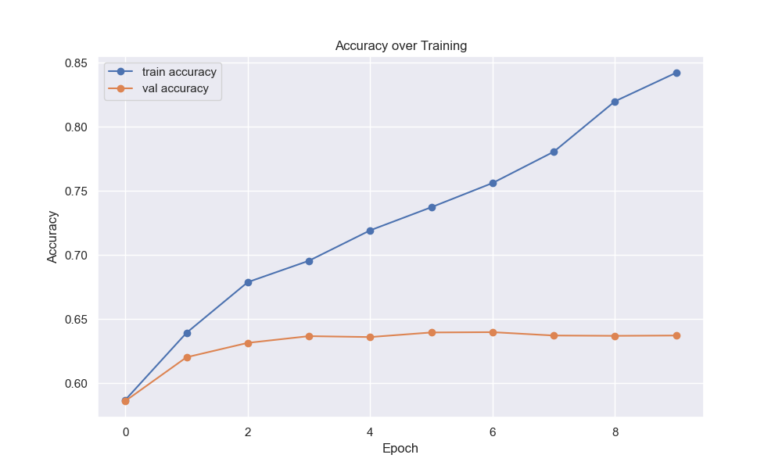
ACCURACY, F-1 SCORE AND LOSS CURVES

Slide 11
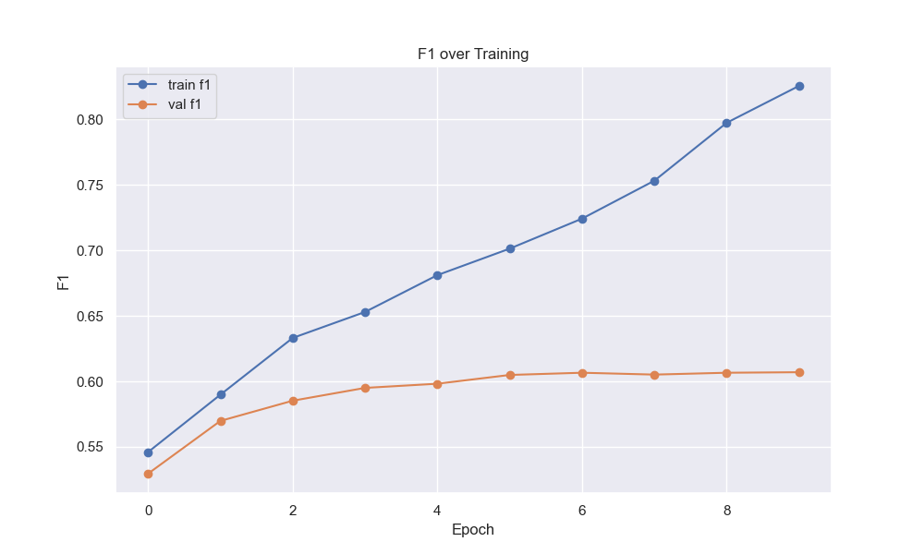
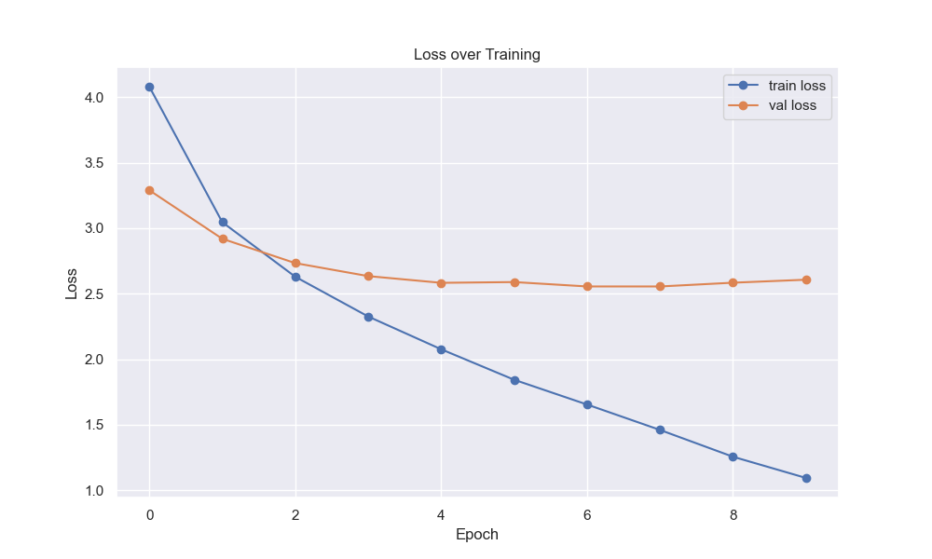

Slide 12
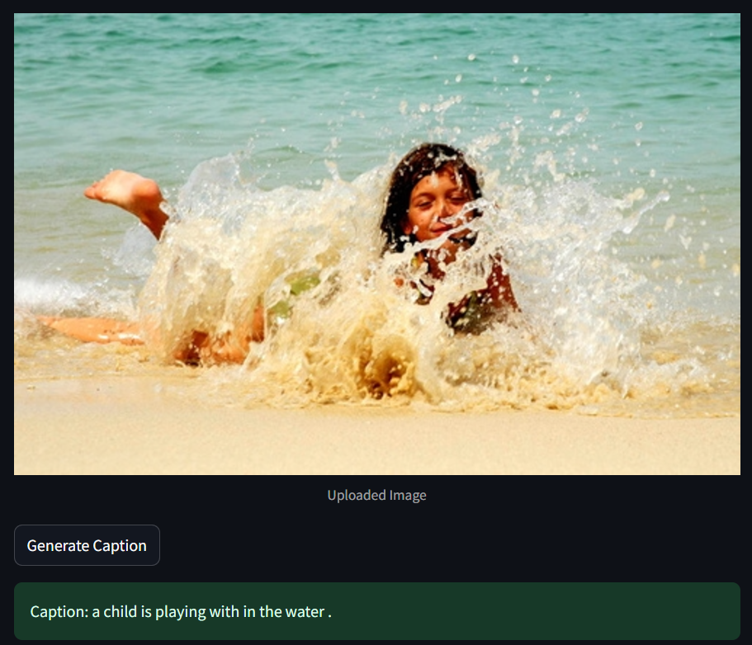
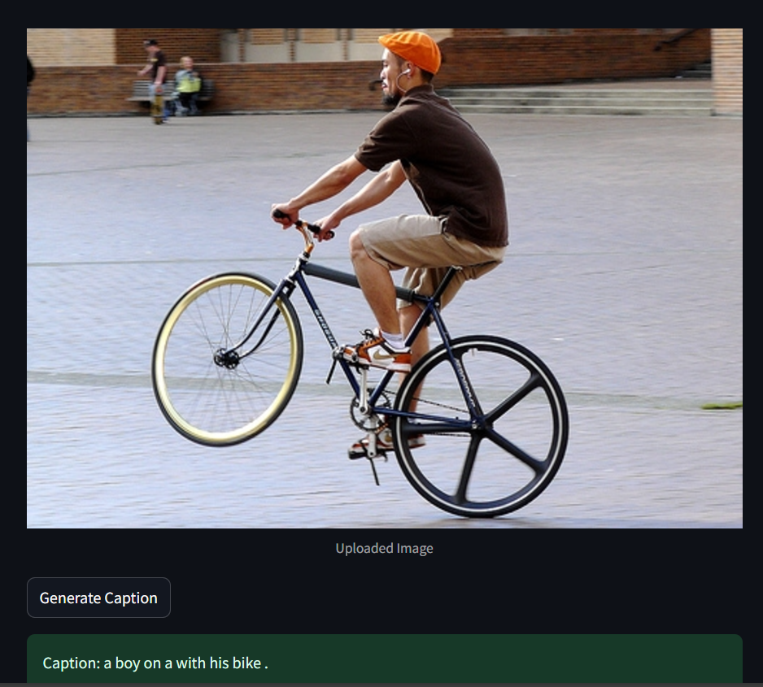
OUTPUT SNIPPITS

Slide 13
CONCLUSION AND RECOMMENDATIONS
CONCLUSION:
The proposed visual attention-based image captioning model effectively enhances the quality and relevance of generated captions by focusing on salient regions in the image.
The interactive Streamlit interface showcases the practical utility of the model, allowing real-time caption generation for any uploaded image.
The model outperforms traditional captioning models in terms of both qualitative and quantitative metrics, especially in context-specific caption generation.
RECOMMENDATIONS:
Future work could explore transformer-based attention mechanisms for further improvements in performance and efficiency.
Further multimodal learning techniques could be incorporated to combine visual features with additional data like textual descriptions or metadata.
Robust vocabulary handling strategies could be developed to improve the model's ability to handle out-of-vocabulary or rare words.

Slide 14
REFERENCES
LLaVA: A Visual Language Model for Few-Shot Learning (Liu et al., 2023)
Revisit Large-Scale Image-Caption Data in Pre-training Multimodal Foundation Models (Li et al., 2024)
VeCLIP: A Multimodal Model for Vision and Language (Lai et al., 2024)
ShareGPT4V: Multimodal Instruction-Following LLM (Chen et al., 2024)
Image Caption Generator (Trushna Kapadnis et al., 2023)

Slide 15
THANK YOU

